Slide 1
Appreciating Diversity
Chapter 13

Slide 2
What is diversity?

Slide 3
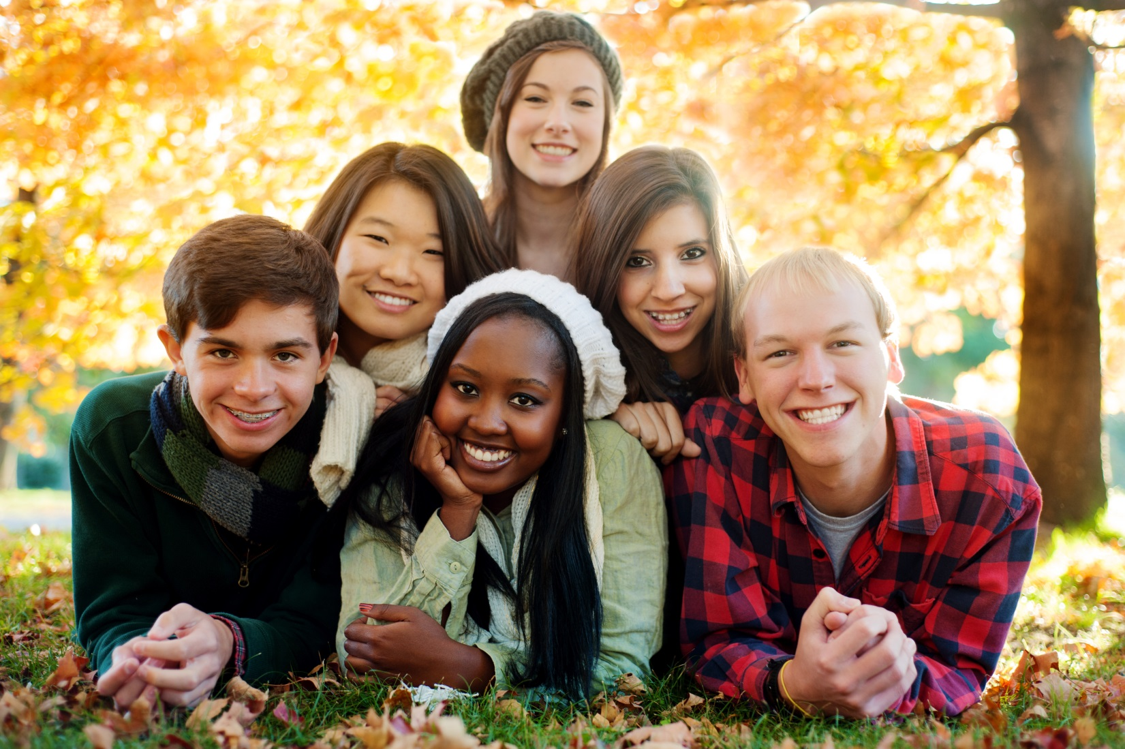
We Are All Different

Slide 4
RACE
TALENTS
HOBBIES
LANGUAGE
RELIGION
SPORTS
INTERESTS
ABILITIES
POLITICS
HEIGHT
HAIR COLOR
PERSONALITIES

Slide 5
Exercise:
Find Someone Who

Slide 6
Diversity is Increasing
Colleges
Businesses
California
USA
The World

Slide 7

Diversity is Important

Slide 8

Global Economy

Slide 9
Global Economy
Increased international trade
NAFTA
The Euro

Slide 10

Electronic Village

Slide 11
The Electronic Village
Internet
Communication satellites
Cell phones
Fax machines
Computers

Slide 12
Success at school and work
Gain skills in critical thinking.
Have pride in yourself and your culture.
Gain an ability to network and learn from others.
Improve interpersonal skills.
Learn to be flexible and adapt to the situation.
Develop cultural awareness.

Slide 13
Video: A Class Divided (Brown Eyes, Blue Eyes)
http://www.pbs.org/wgbh/pages/frontline/shows/divided/etc/view.html

Slide 14
Exercise:
Exploring My Culture

Slide 15


Slide 16
Race
A group of people who are perceived to be physically different because of traits such as facial features and color of skin and hair

Slide 17
Ethnicity
A sense of belonging to a particular culture and sharing the group’s beliefs, attitudes, skills, ceremonies and traditions
Descends from a common
group of ancestors usually
from a particular country or
geographic area

Slide 18
Ethnocentrism
The belief that one’s own ethnic, religious or political group is superior to all others
An example of ethnocentrism
is the belief that Columbus
discovered the new world.

Slide 19
Culture
The behavior, beliefs and values shared by a group of people
Language, morals and even food preferences
What we learn from the
people around us

Slide 20
Gender and Sex
Gender refers to the cultural differences that distinguish males from females.
Different cultures raise men and women to act in specified ways.
Sex refers to anatomical
differences.

Slide 21
Sexism
A negative attitude based on sex

Slide 22
Stereotype
Based on generalizations
Can lead to discrimination
Causes us to view others in limited ways

Slide 23
Exercise:
Exploring Stereotypes

Slide 24
Why do we stereotype?
It is a fast way to make sense of the world.
We look for patterns to understand the world.
We are often unable or unwilling to find all the information we need.
Stereotypes result from fear of people who are different.
The media promotes stereotypes.

Slide 25
Problems from Stereotypes
We do not get to know persons as individuals.
All members of a culture, ethnic group or gender are not alike.
Stereotypes lead to prejudice and discrimination.

Slide 26
Prejudice
It means pre-judgment
A harmful attitude based on a stereotype
It results when people are
insecure about their identities

Slide 27
Discrimination
When people are denied opportunities because of their differences
Prejudice and stereotype are often involved

Slide 28
Racism
When one race or ethnic group holds a negative attitude or perception of another group
It is a prejudice based on race
Scientists accept the fact that
no race is superior to another
People who believe that their
race is superior are called
racists

Slide 29
Cultural Pluralism
When each group celebrates the customs and traditions of their culture while participating in the mainstream society

Slide 30
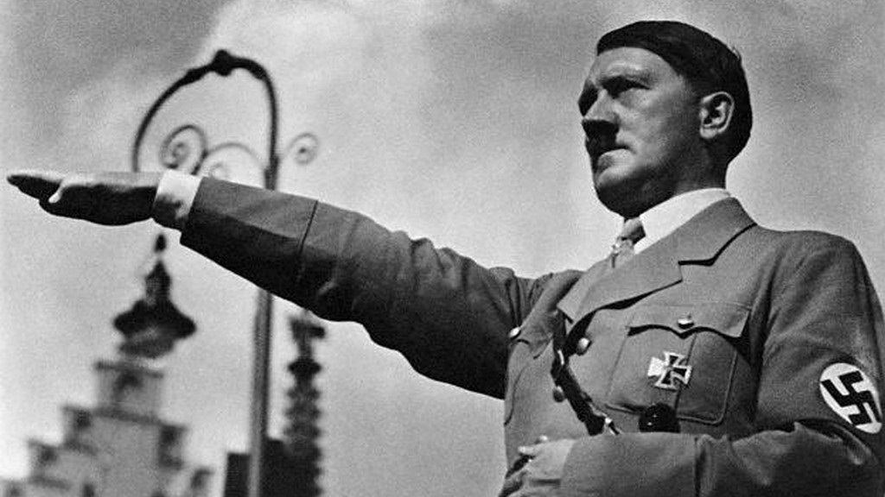
Genocide
The deliberate and systematic destruction of a racial, political, religious or cultural group

Slide 31
About 7.2 Billion People in the World
If all were represented by 100 people, we would have:
  60 Asians
  16 Africans
  10 Europeans
  9 Central and South Americans
  5 North Americans (Canada and
  the U.S.)

Slide 32
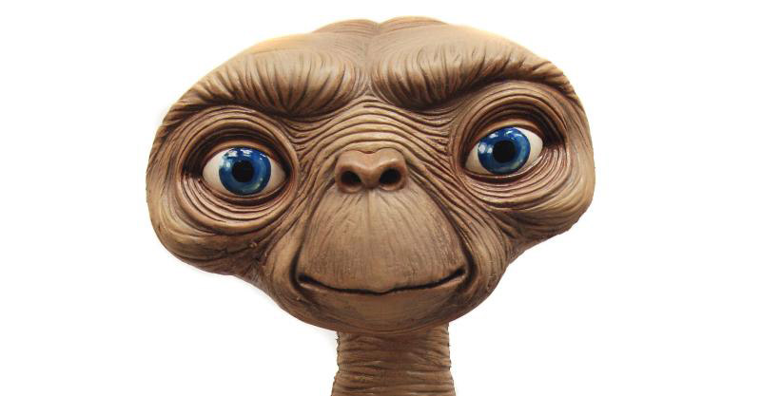
If an Extra Terrestrial arrived from another planet, how would they describe the average human?

Slide 33
The Alien Report
The average human being is of Asian descent.
50% of the people of the world suffer from malnutrition.
80% live in substandard housing.
There are continuous wars and fighting resulting in much human suffering.

Slide 34
The Alien Report
In our representative sample, six people would own half of the wealth of the world.
These 6 people would include
  3 from the U.S.
  2 from Japan
  1 from Germany

Slide 35
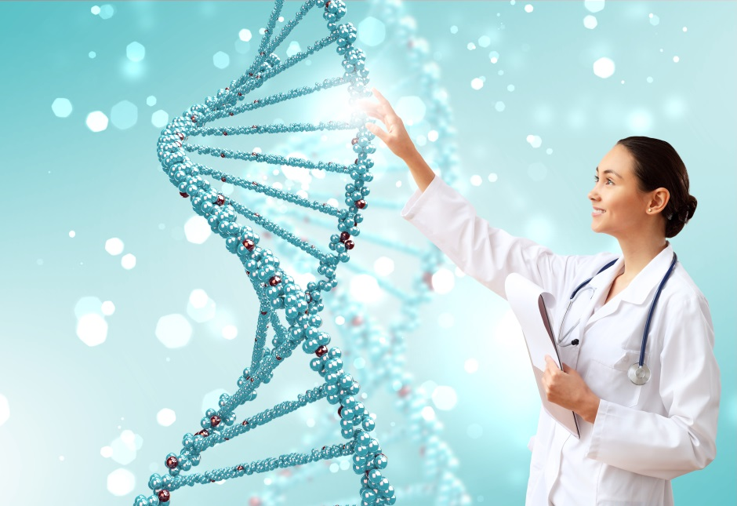
The Human Genome Project shows we are all alike inside.

Slide 36
The Human Genome Project
Human beings are 99.9 % identical.
Each person has a unique combination of DNA which forms his or her genetic code.
We all evolved in the last 100,000 years from the same small number of tribes that migrated out of Africa and colonized the world.

Slide 37
The Human Genome Project
The genes responsible for outward appearance are only .01 percent.
People who lived near the equator evolved dark skin to protect from ultraviolet rays.
People who lived far from the equator evolved lighter skins to produce
vitamin D from very little sunlight.

Slide 38
Communicating Across Cultures

Slide 39
Symbols
Symbols are a word that stands for something else.
Problems arise when we assume the symbol has only one meaning and that everyone understands the symbol the same say.

Slide 40
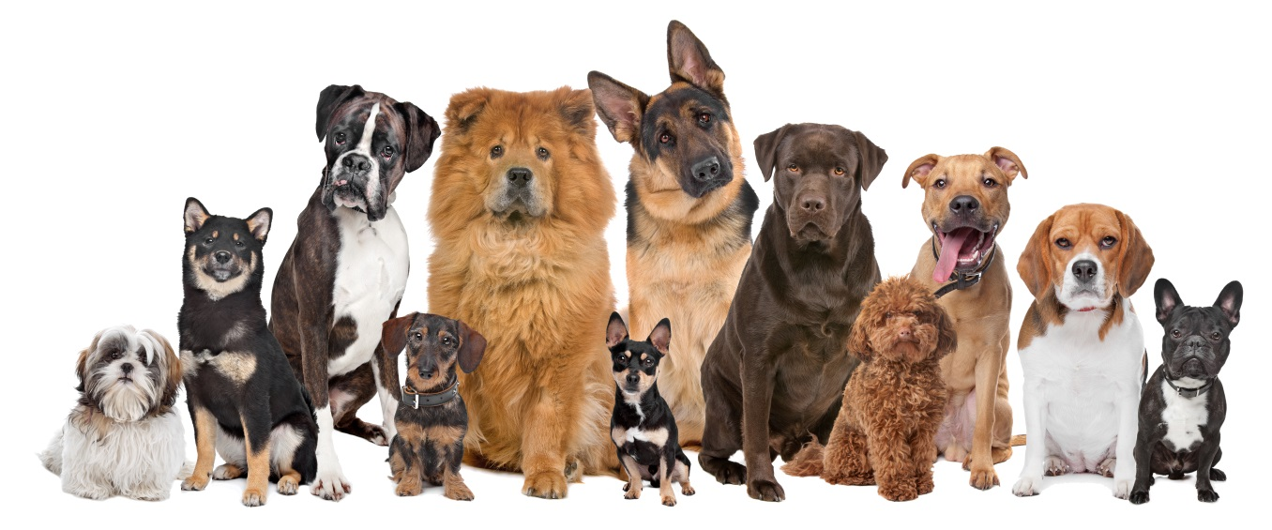
“Dog” has many meanings:
He led a dog’s life.
He was in the dog house.
Doggone it!
He at a hot dog.
He is a lucky dog.
The book is dog-eared.
My dogs hurt.
May I have a doggy bag?

Slide 41
Communicating Across Cultures
Communication is difficult and errors are likely.
The message sent is not always the message received.
Give people time to think and respond.
Speaking louder does not help.
Check your understanding of the message.

Slide 42
Communicate Across Cultures
If you feel insulted, remember that you can be misinterpreting the message.
Remain calm and treat others with respect.
Study a different language.
Use nonverbal communication.
Don’t forget your sense of humor!

Slide 43
Another type of diversity. . .

Slide 44

Understanding Sexual Orientation
10% of the population is gay, lesbian or bisexual.
Homosexuality is not something that one chooses or learns to be.
Approximately one out
of four families has a gay
member of the family.

Slide 45
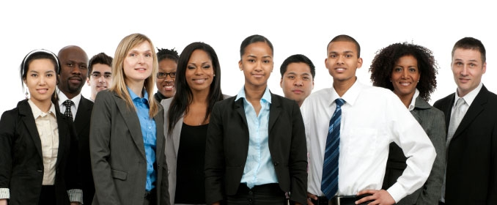
How can you learn to appreciate diversity?

Slide 46
Appreciating Diversity
Educate yourself about other cultures and people who are different from you.
Take pride in and explore your own heritage.
Value diversity and accept the differences of others.
View differences as an opportunity for learning.

Slide 47
Appreciating Diversity
Travel to other countries.
Study another language.
Find common ground.
Avoid judgments based on physical appearance.
Teach your children to value diversity.

Slide 48
Assignment: Diversity Poster
Use the 5X8 card to describe what makes you unique. Use drawings, magazine photos, colors.

Slide 49
Diversity Poster
Include language, culture,
sports, hobbies, religion,
interests, values, or anything
else that makes you
unique.

Slide 50
Please Do Not Include:
Sex
Guns
Violence
Drugs
Alcohol

Slide 51

Stages of Ethical Development:
William Perry
Dualism
Multiplicity
Relativism
Commitment
in Relativism

Slide 52
Dualism
Think in terms of black or white, good or bad, right or wrong
Role models or authorities determine what is “right”
Decisions based on common stereotypes

Slide 53
Multiplicity
There are multiple possibilities and answers
Authorities disagree on what is “right” or “wrong”
We defend our position, but realize that everyone has a right to his or her opinion

Slide 54
Relativism
What is right is based on our own values and culture
We weigh the evidence and try to support our opinions based on data and evidence

Slide 55
Commitment in Relativism
In an uncertain world, we make decisions about careers, politics, and personal relationships based on our personal values.
We make certain commitments about the way we wish to live our lives.
We defend our values, but respect the values of others.

Slide 56
Keys to Success:
Diversity is valuable and people are important.
The Dash Movie: http://www.thedashmovie.com/

Slide 57
Exercise:
Exploring Diversity

Slide 58


